Slide 1
Isabella’s Concert
Isabella Stewart Gardner and Johannes Vermeer’s Reputation in the Nineteenth Century

Slide 2
Johannes Vermeer, The Concert, c. 1663-1666. Oil on canvas, 28.5x25.5in. Isabella Stewart Gardner Museum, Boston. (Stolen March 18, 1990)

Slide 3
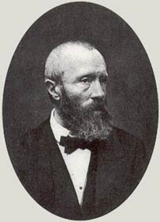
Théophile Thoré-Bürger
1807-1869
French art critic, collector, and connoisseur
1866: Exposition Retrospective, Paris
1870 and 1892: auctions of personal art collection

Slide 4
Anders Zorn, Portrait of Isabella Stewart Gardner In Venice, 1894 Isabella Stewart Gardner Museum, Boston.

Slide 5
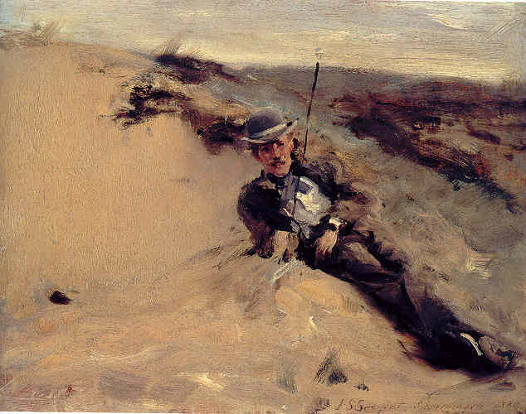
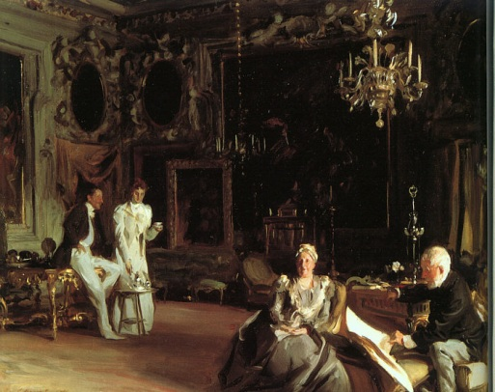
John Singer Sargent, Ralph Curtis on the Beach at Scheveningen, 1880. Oil on canvas, High Museum of Art, Atlanta.
John Singer Sargent, An Interior in Venice, 1899. Oil on canvas, Royal Academy of the Arts, London.

Slide 6
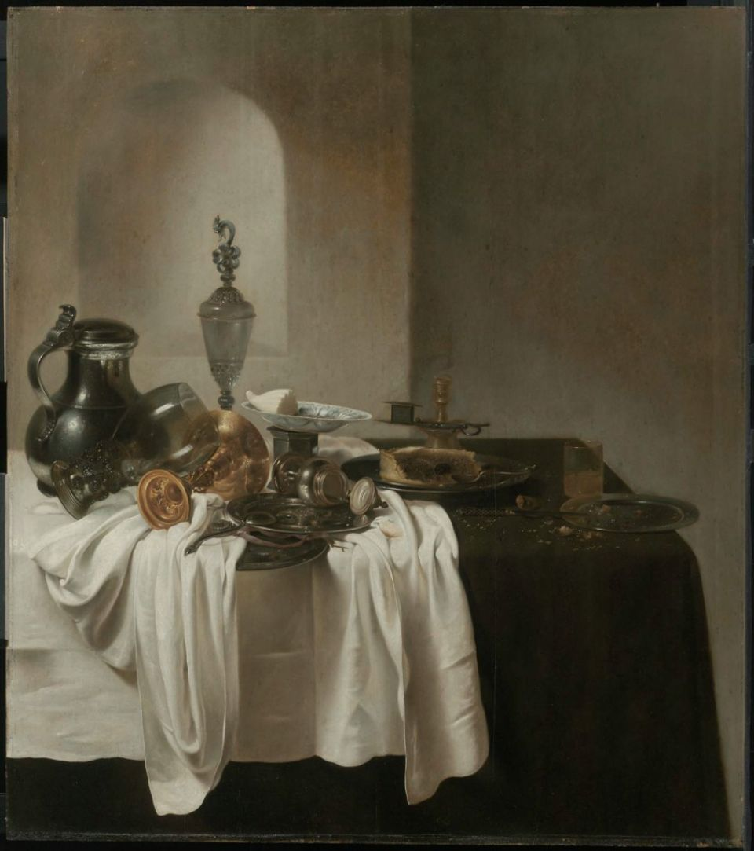
Frank Duveneck, Portrait of Ralph Curtis, 1872 Oil on canvas. Private Collection.
Jan Jansz den Uyl, Breakfast Still Life with Glass and Metalwork, 1637-1639. Oil on canvas. Museum of Fine Arts, Boston.

Slide 7
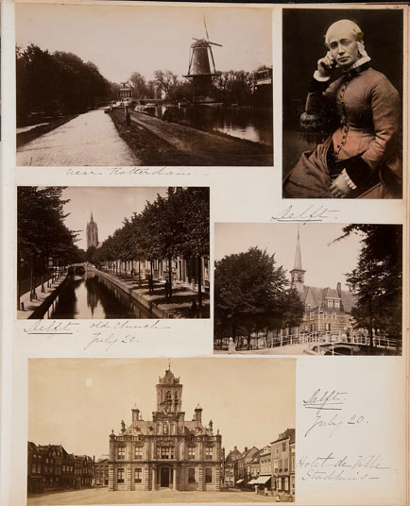
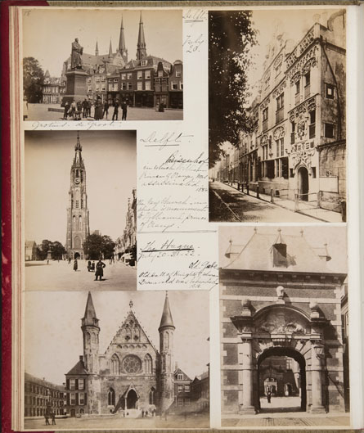
Pages 16 & 17 of Isabella Stewart Gardner’s Travel Album 1890: Netherlands, Germany, Italy

Slide 8
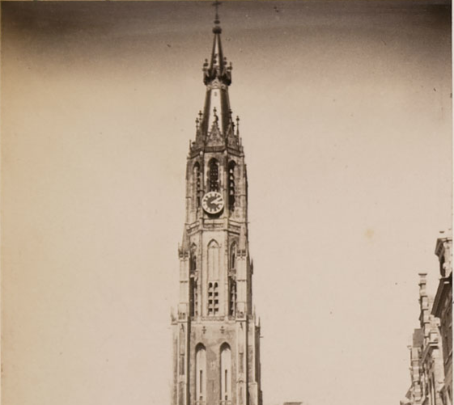
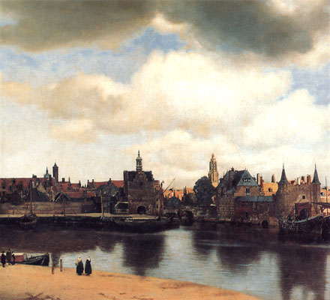
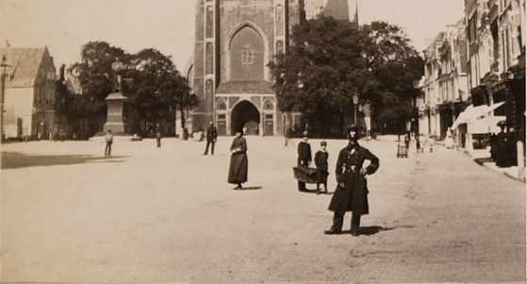
Niewe Kerk, Delft, 1890 Isabella Stewart Gardner Museum Archives
Johannes Vermeer, View of Delft,
c. 1660-1661. Oil on canvas. Maruritshuis Museum, The Hague.

Slide 9
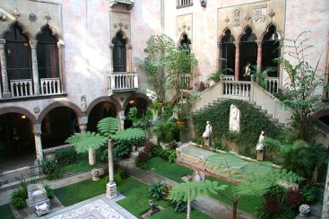
Johannes Vermeer, The Concert, c. 1663-1666. Oil on canvas, 28.5x25.5in. Isabella Stewart Gardner Museum, Boston.
Courtyard, Isabella Stewart Gardner Museum

Slide 10
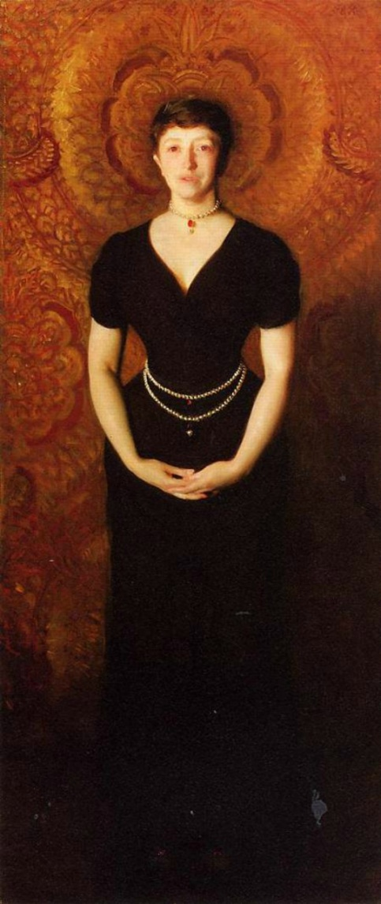
Johannes Vermeer, The Concert, c. 1663-1666. Oil on canvas, 28.5x25.5in. Isabella Stewart Gardner Museum, Boston.
J. S. Sargent, Portrait of Isabella Stewart Gardner, 1888.
Oil on canvas, Isabella Stewart Gardner Museum , Boston.

